Slide 1
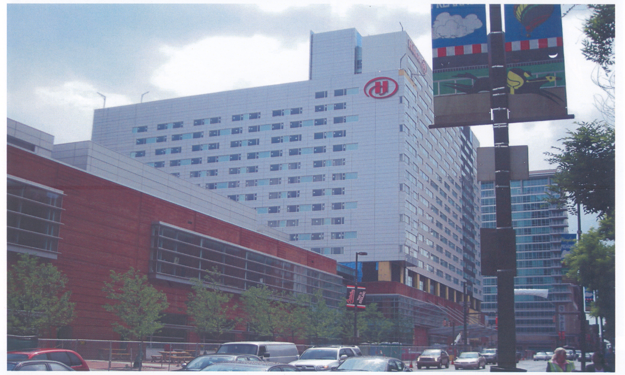
Baltimore Hilton Convention Center
Baltimore, MD
Christopher Simmons l Structural Option
AE Senior Thesis l Spring 2010
Faculty Consultant l Dr. Ali M. Memari

Slide 2
Existing Building Information
Project Goals
Structural Depth Study
Construction Management Breadth Study
Outline
Acoustical Breadth Study
Conclusions
Acknowledgements
Questions and Comments

Slide 3
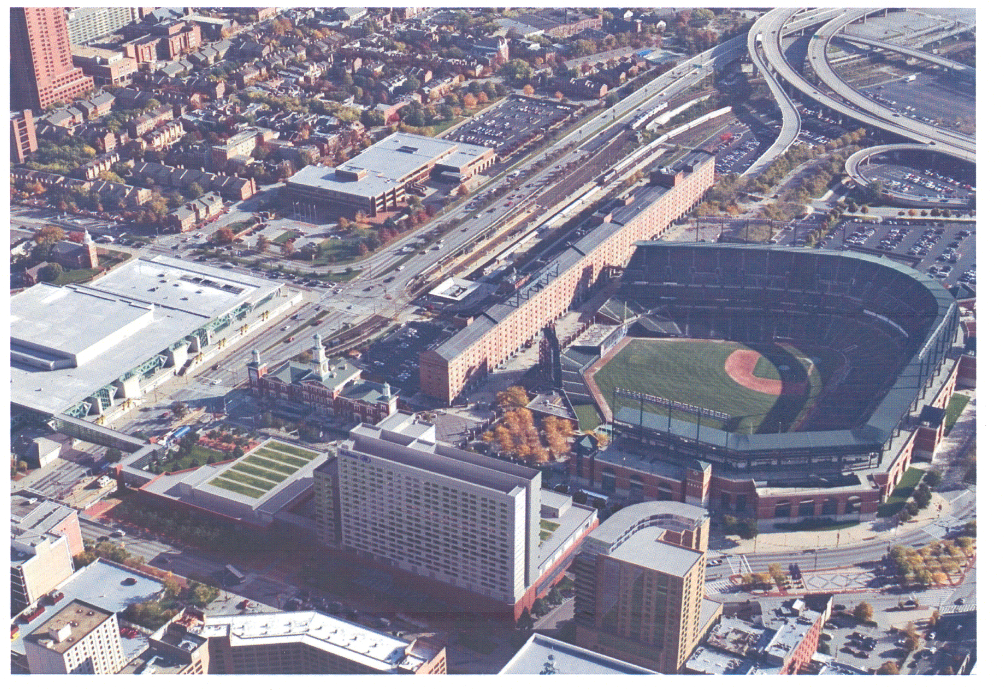
Existing Building Information
Project Goals
Structural Depth Study
Construction Management Breadth Study
Acoustical Breadth Study
Conclusions
Acknowledgements
Questions and Comments
Existing Building Information

Slide 4
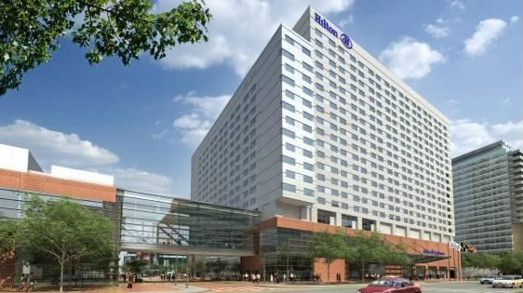
Existing Building Information
Project Goals
Structural Depth Study
Construction Management Breadth Study
Acoustical Breadth Study
Conclusions
Acknowledgements
Questions and Comments
Location
401 West Pratt Street
Building Statistics
Size | 900,000 sq. ft.
Stories | 20 stories
  2 levels of underground parking
Project Cost
$250 million

Slide 5
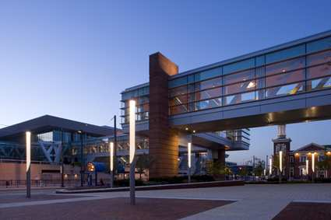
Existing Building Information
Project Goals
Structural Depth Study
Construction Management Breadth Study
Acoustical Breadth Study
Conclusions
Acknowledgements
Questions and Comments
Architectural Concepts
Enclosed Pedestrian Walkway
Corrugated Metal Paneling
Sustainability
Green Roof

Slide 6
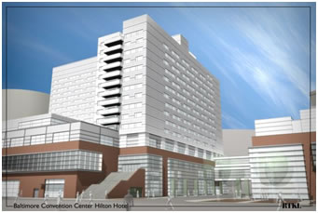
Existing Building Information
Project Goals
Structural Depth Study
Construction Management Breadth Study
Acoustical Breadth Study
Conclusions
Acknowledgements
Questions and Comments
Mechanical System
2 1,000 ton heat exchangers
8 AHUs
4 MAUs
Electrical System
East Podium | 2000A 480/277 services
West Podium | (2) 4000A 480/277 services
1100 kW emergency generator

Slide 7
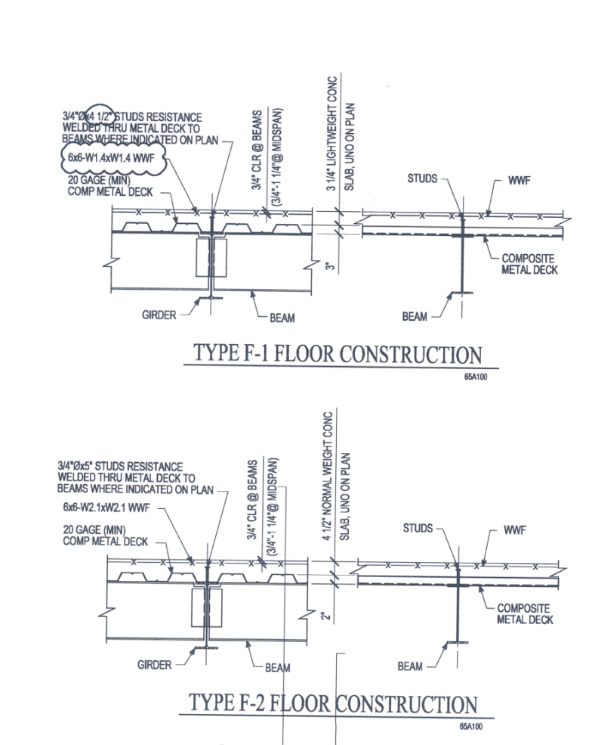
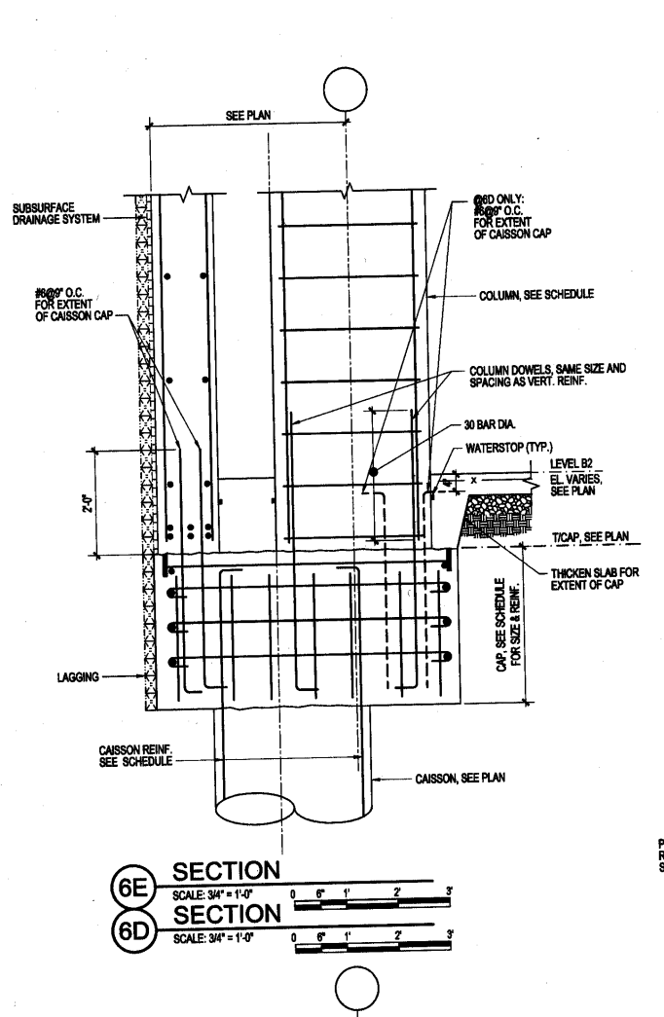
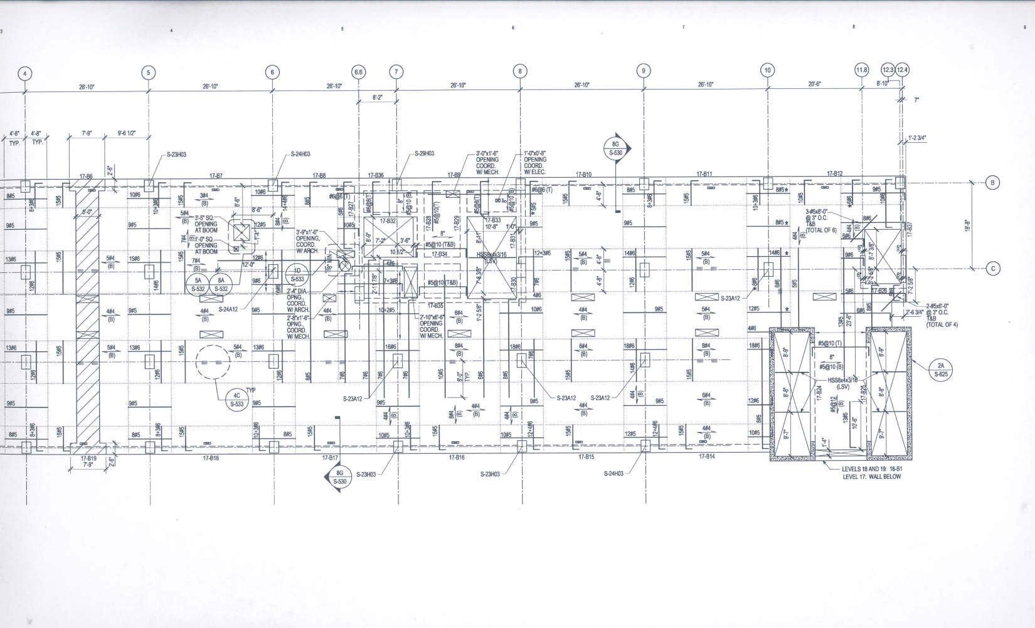
Existing Building Information
Project Goals
Structural Depth Study
Construction Management Breadth Study
Acoustical Breadth Study
Conclusions
Acknowledgements
Questions and Comments
Structural System
9”-11” two-way reinforced concrete slab
4.5” concrete slab on 2” metal decking
Foundation System
  Caissons 14’-32’ below bottom parking
12”-16” thick reinforced concrete shear walls
Reinforced Concrete Columns
  12”x18” – 44”x30”

Slide 8
Existing Building Information
Project Goals
Structural Depth Study
Construction Management Breadth Study
Acoustical Breadth Study
Conclusions
Acknowledgements
Questions and Comments
Project Goals

Slide 9
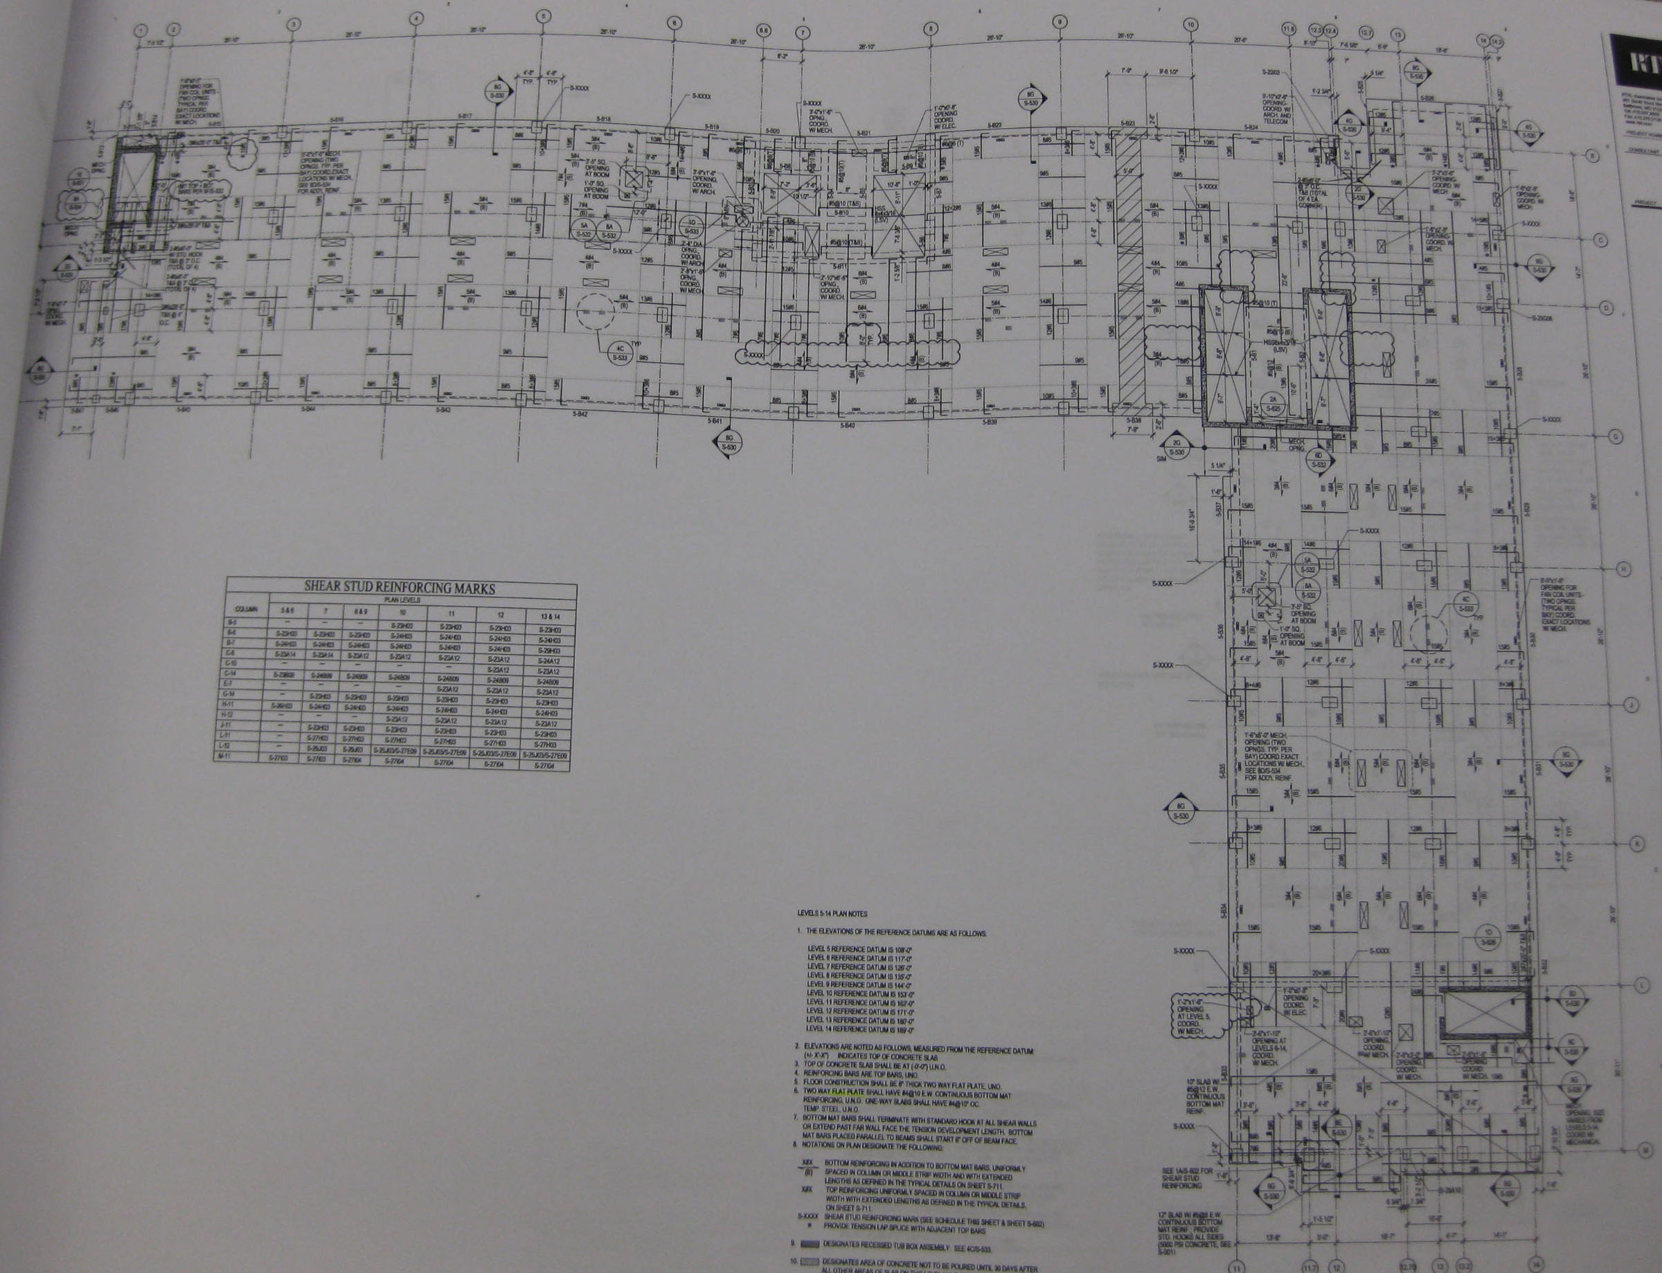
Existing Building Information
Project Goals
Structural Depth Study
Construction Management Breadth Study
Acoustical Breadth Study
Conclusions
Acknowledgements
Questions and Comments
Problem Statement
Floor Slab System
  Floor-to-ceiling height
  Longer spans
  Reduced weight
Lateral System
Foundation System

Slide 10
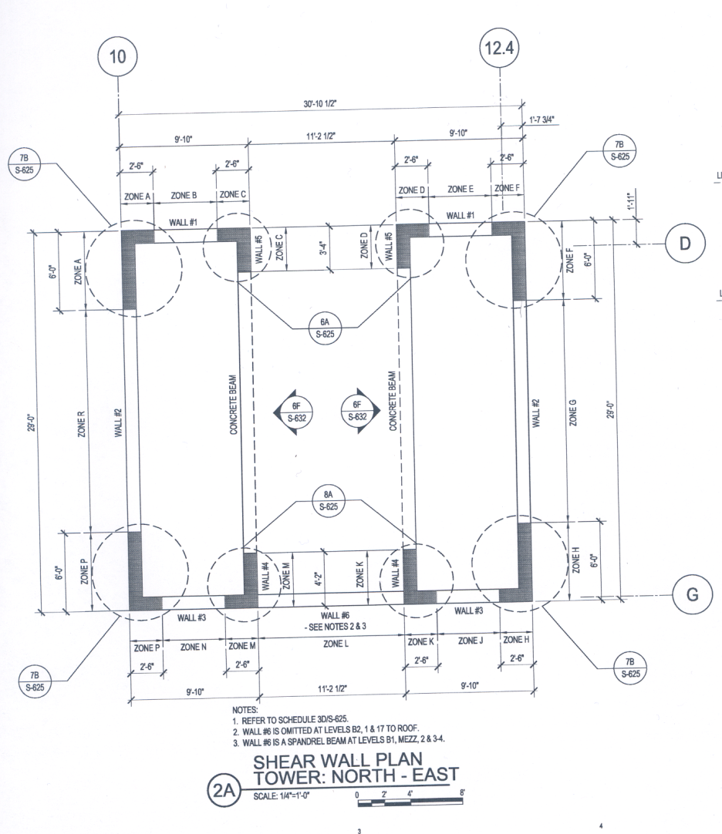
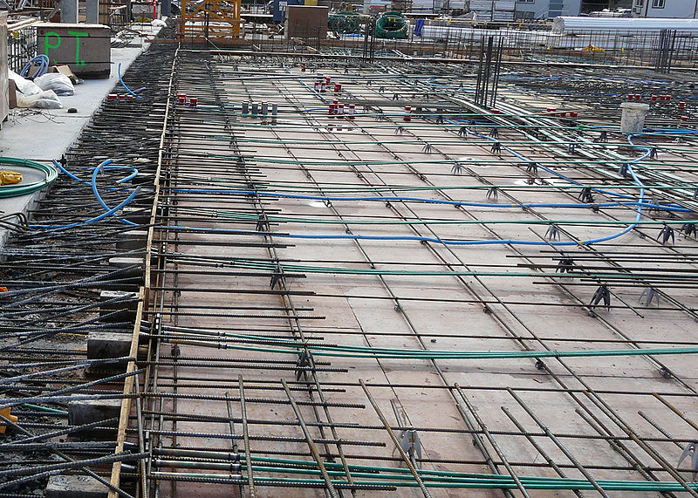
Existing Building Information
Project Goals
Structural Depth Study
Construction Management Breadth Study
Acoustical Breadth Study
Conclusions
Acknowledgements
Questions and Comments
Structural Depth Study | Floor System
Two-way Post-tensioning slabs
Structural Depth Study | Lateral System
Lateral System Check
Structural Depth Study | Foundation System
Foundation Check
Construction Management Breadth Study
Cost and Schedule Analysis
Acoustical Breadth Study
Floor System | Exercise Room and Pool Area

Slide 11
Existing Building Information
Project Goals
Structural Depth Study
Construction Management Breadth Study
Acoustical Breadth Study
Conclusions
Acknowledgements
Questions and Comments
Structural Depth Study

Slide 12
Design Loads
  ASCE 7-05
    Live load values
    Superimposed load values – RTKL
    Snow
  Controlling load combination
    1.2 SW + 1.6 LL + 1.2 SDL
Existing Building Information
Project Goals
Structural Depth Study
Construction Management Breadth Study
Acoustical Breadth Study
Conclusions
Acknowledgements
Questions and Comments
Design Value
DEAD (DL)
150pcf
20psf
LIVE (LL)*
40psf
100psf
100psf
40psf
100psf
75psf
100psf
100psf
20psf
SNOW (S)
20psf
Table 1 - Gravity Loads
Description | ASCE 7-05 | RTKL Value | Design Value
DEAD (DL)
Concrete | 150pcf | 150pcf | 150pcf
Ceiling, Mech, Ducts, etc. | 20-25psf | 5-20psf | 20psf
LIVE (LL)*
Private Hotel Rooms | 40psf | 40psf | 40psf
Ballroom | 100psf | 100psf | 100psf
Corridors (first floor, main lobby) | 100psf | 100psf | 100psf
Corridors (serving private hotel rooms) | 100psf | 40psf | 40psf
Aerobic/Exercise Rooms | 100psf | 100psf | 100psf
Pool Deck | 75psf | 80psf | 75psf
Green Roof | 100psf | 100psf | 100psf
Exterior Balconies (East Tower) | 100psf | 100psf | 100psf
Roofing | 20psf | 30psf | 20psf
SNOW (S)
Snow | 20psf | 20psf | 20psf
* Live load reductions were not taken into consideration in the design.

Slide 13
Modeling Process
  Determine Slab Thicknesses
    Structural Requirements
    Beam and Column Layout
  Model in ADAPT
    Concrete strength | f’_{c} = 5 ksi | f’_{ci} = 3 ksi
    Dimensions
    Application of design loads
  Analysis
    Forces & stresses
    Displacements
Existing Building Information
Project Goals
Structural Depth Study
Construction Management Breadth Study
Acoustical Breadth Study
Conclusions
Acknowledgements
Questions and Comments

Slide 14
Existing Building Information
Project Goals
Structural Depth Study
Construction Management Breadth Study
Acoustical Breadth Study
Conclusions
Acknowledgements
Questions and Comments
Change in Thickness (in)
2
-1
-1
1
-2
-2
-2
-2
-2
-2
-2
-2
-2
-2
-2
-2
-2
-2
-2
-2
Table 2 - Floor Slab Thickness Comparison
Level | Designed Two-Way Post-tensioning Thickness (in) | Existing Two-Way Flat Plate Thickness (in) | Change in Thickness (in)
Floor 1 | 11 | 9 | 2
Mezzanine | 8 | 9 | -1
Floor 2 | 8 | 9 | -1
Floor 3 | 10 | 9 | 1
Floor 4 | 6 | 8 | -2
Floor 5 | 6 | 8 | -2
Floor 6 | 6 | 8 | -2
Floor 7 | 6 | 8 | -2
Floor 8 | 6 | 8 | -2
Floor 9 | 6 | 8 | -2
Floor 10 | 6 | 8 | -2
Floor 11 | 6 | 8 | -2
Floor 12 | 6 | 8 | -2
Floor 13 | 6 | 8 | -2
Floor 14 | 6 | 8 | -2
Floor 15 | 6 | 8 | -2
Floor 16 | 6 | 8 | -2
Floor 17 | 6 | 8 | -2
Floor 18 | 6 | 8 | -2
Floor 19 | 6 | 8 | -2

Slide 15
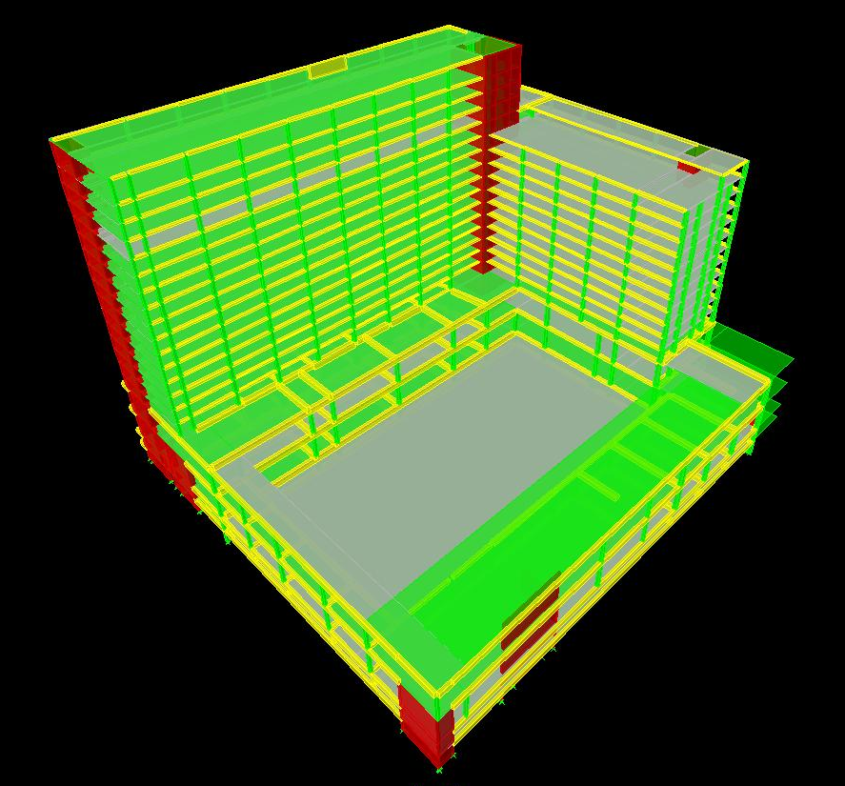
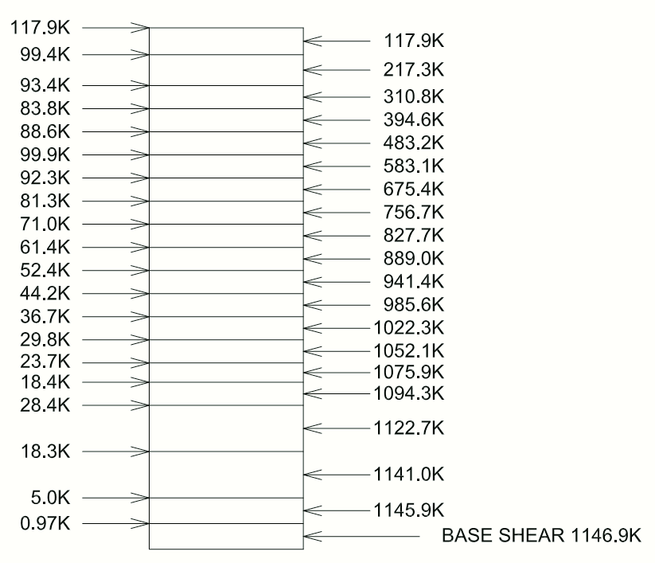
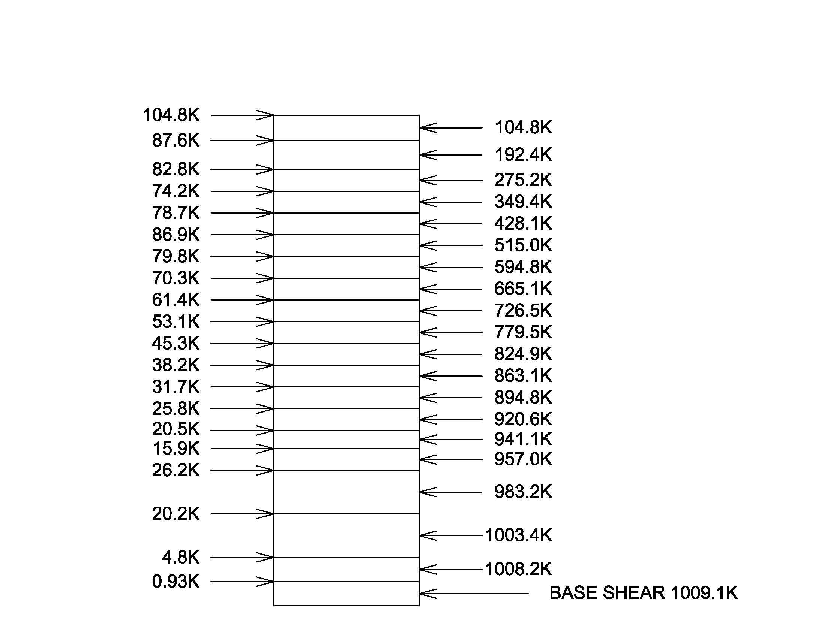
Existing Building Information
Project Goals
Structural Depth Study
Construction Management Breadth Study
Acoustical Breadth Study
Conclusions
Acknowledgements
Questions and Comments
Post-Tensioning
Floor Dead Weight
Level | Walls | MEP | Columns | Beams | Slabs | Drop Panels | Roof | Total
Mezzanine | 331.13 | 59.13 | 1235.69 | 2366.4 | 5652.09 | 21.71 | 0 | 9666.15
2 | 397.35 | 59.13 | 912.94 | 3248 | 7629.76 | 103.40 | 0 | 12350.58
3 | 353.39 | 59.13 | 912.94 | 3781.6 | 9315.43 | 17.28 | 0 | 14439.76
4 | 179.55 | 59.13 | 288.50 | 1948.8 | 3089.32 | 0 | 3081.59 | 8646.89
5 | 179.55 | 59.13 | 288.50 | 1090.4 | 2283.25 | 0 | 0 | 3900.84
6 | 179.55 | 59.13 | 288.50 | 1090.4 | 2257.11 | 0 | 0 | 3874.69
7 | 179.55 | 59.13 | 288.50 | 1090.4 | 2257.11 | 0 | 0 | 3874.69
8 | 179.55 | 59.13 | 288.50 | 1090.4 | 2257.11 | 0 | 0 | 3874.69
9 | 179.55 | 59.13 | 288.50 | 1090.4 | 2257.11 | 0 | 0 | 3874.69
10 | 179.55 | 59.13 | 288.50 | 1090.4 | 2257.11 | 0 | 0 | 3874.69
11 | 179.55 | 59.13 | 288.50 | 1090.4 | 2257.11 | 1.80 | 0 | 3876.49
12 | 179.55 | 59.13 | 288.50 | 1090.4 | 2257.11 | 0 | 0 | 3874.69
13 | 179.55 | 59.13 | 288.50 | 1090.4 | 2257.11 | 0 | 0 | 3874.69
14 | 179.55 | 59.13 | 288.50 | 1090.4 | 2257.11 | 0 | 0 | 3874.69
15 | 127.51 | 59.13 | 288.50 | 1044 | 2101.59 | 0 | 119.73 | 3740.47
16 | 127.51 | 59.13 | 288.50 | 1067.2 | 1483.25 | 0 | 0 | 3025.60
17 | 77.91 | 59.13 | 288.50 | 858.4 | 1279.99 | 0 | 0 | 2563.93
18 | 77.91 | 59.13 | 288.50 | 881.6 | 1279.99 | 0 | 0 | 2587.13
19 | 77.91 | 59.13 | 209.85 | 858.4 | 1279.99 | 0 | 0 | 2485.28
20 | 0 | 59.13 | 130.07 | 858.4 | 1279.99 | 0 | 302.12 | 2629.71
Total | 3545.66 | 1182.65 | 7729.02 | 27816.80 | 56988.62 | 144.18 | 3503.44 | 100910.36
Reinforced Concrete
Floor Dead Weight
Level | Walls | MEP | Columns | Beams | Slabs | Drop Panels | Roof | Total
Mezzanine | 331.13 | 59.13 | 1235.69 | 2366.4 | 6358.60 | 21.71 | 0 | 10372.66
2 | 397.35 | 59.13 | 912.94 | 3248 | 8583.48 | 103.40 | 0 | 13304.30
3 | 353.39 | 59.13 | 912.94 | 3781.6 | 8383.89 | 17.28 | 0 | 13508.22
4 | 179.55 | 59.13 | 288.50 | 1948.8 | 4119.09 | 0 | 3081.59 | 9676.67
5 | 179.55 | 59.13 | 288.50 | 1090.4 | 3044.34 | 0 | 0 | 4661.92
6 | 179.55 | 59.13 | 288.50 | 1090.4 | 3009.47 | 0 | 0 | 4627.06
7 | 179.55 | 59.13 | 288.50 | 1090.4 | 3009.47 | 0 | 0 | 4627.06
8 | 179.55 | 59.13 | 288.50 | 1090.4 | 3009.47 | 0 | 0 | 4627.06
9 | 179.55 | 59.13 | 288.50 | 1090.4 | 3009.47 | 0 | 0 | 4627.06
10 | 179.55 | 59.13 | 288.50 | 1090.4 | 3009.47 | 0 | 0 | 4627.06
11 | 179.55 | 59.13 | 288.50 | 1090.4 | 3009.47 | 1.80 | 0 | 4628.86
12 | 179.55 | 59.13 | 288.50 | 1090.4 | 3009.47 | 0 | 0 | 4627.06
13 | 179.55 | 59.13 | 288.50 | 1090.4 | 3009.47 | 0 | 0 | 4627.06
14 | 179.55 | 59.13 | 288.50 | 1090.4 | 3009.47 | 0 | 0 | 4627.06
15 | 127.51 | 59.13 | 288.50 | 1044 | 2802.12 | 0 | 119.73 | 4441.00
16 | 127.51 | 59.13 | 288.50 | 1067.2 | 1977.67 | 0 | 0 | 3520.02
17 | 77.91 | 59.13 | 288.50 | 858.4 | 1706.65 | 0 | 0 | 2990.60
18 | 77.91 | 59.13 | 288.50 | 881.6 | 1706.65 | 0 | 0 | 3013.80
19 | 77.91 | 59.13 | 209.85 | 858.4 | 1706.65 | 0 | 0 | 2911.94
20 | 0 | 59.13 | 130.07 | 858.4 | 1706.65 | 0 | 302.12 | 3056.37
Total | 3545.66 | 1182.65 | 7729.02 | 27816.80 | 69181.08 | 144.18 | 3503.44 | 113102.83
Seismic Analysis
  ETABS Model
  Building Weight
  Base Shear

Slide 16
Existing Building Information
Project Goals
Structural Depth Study
Construction Management Breadth Study
Acoustical Breadth Study
Conclusions
Acknowledgements
Questions and Comments
Structural Depth Study Conclusion

Slide 17
Existing Building Information
Project Goals
Structural Depth Study
Construction Management Breadth Study
Acoustical Breadth Study
Conclusions
Acknowledgements
Questions and Comments
Construction Management Breadth Study

Slide 18
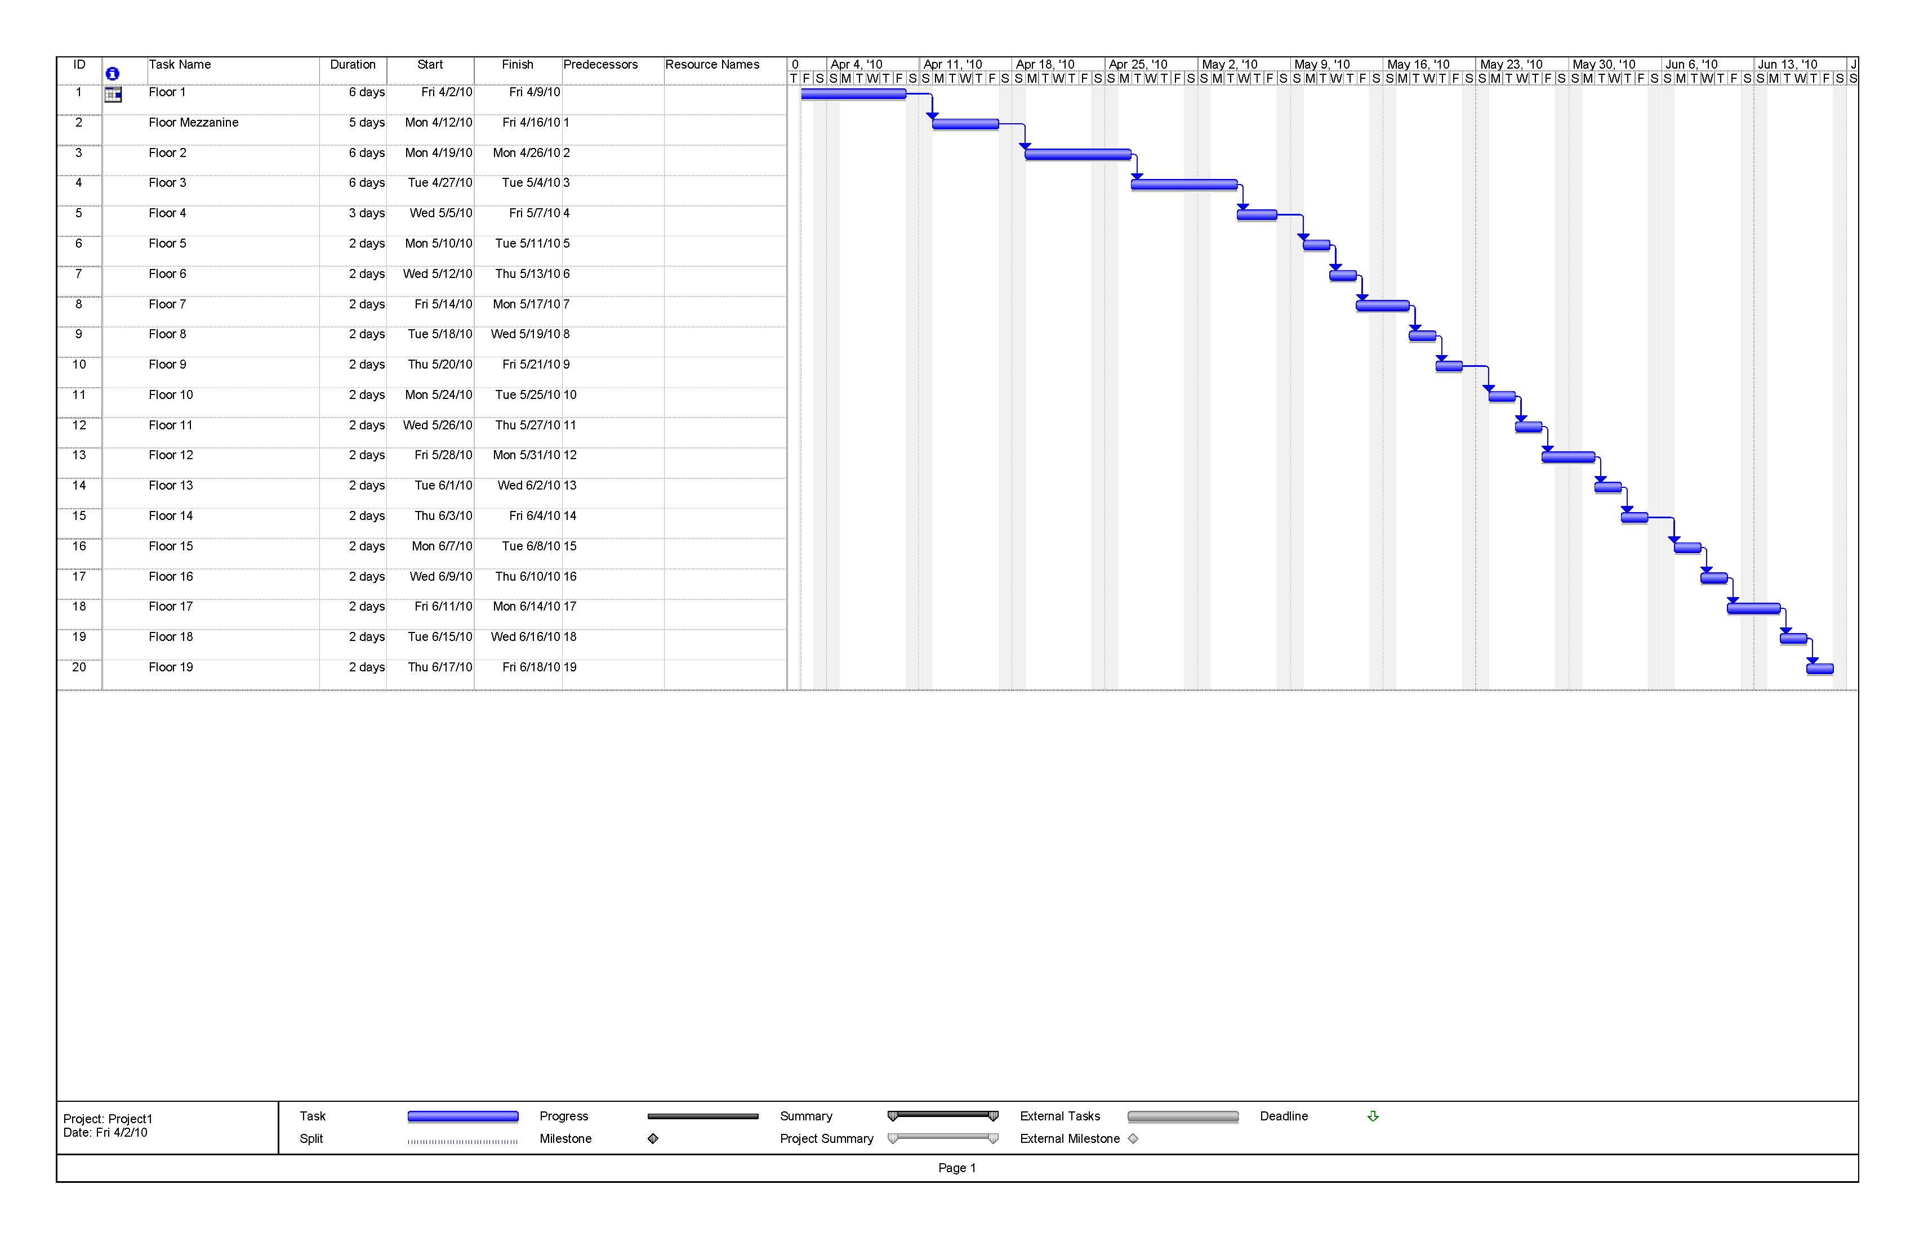
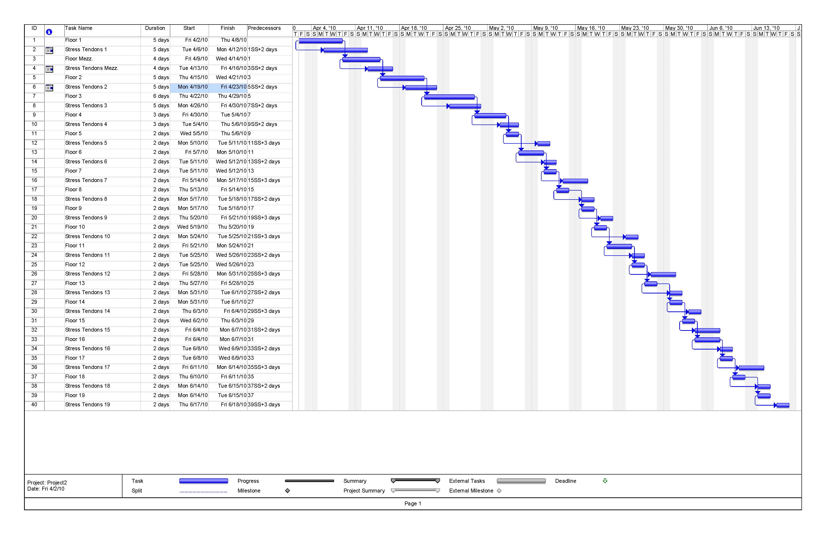
Existing Building Information
Project Goals
Structural Depth Study
Construction Management Breadth Study
Acoustical Breadth Study
Conclusions
Acknowledgements
Questions and Comments
Table 4 - Floor System Cost Comparison
Material | Designed Two-Way Post-tensioning (Dollars) | Existing Two-Way Flat Plate (Dollars) | Change in Cost
Concrete Mix (4000 PSI for Existing and 5000 PSI for PT) | 1,853,245.98 | 2,121,912.45 | -$268,666.47
Mild Reinforcing Steel | 299,136.16 | 1,585,937.40 | -$1,286,801.24
Prestressing Steel Tendons | 541,451.52 | 0 | $541,451.52
Concrete Placing | 358,553.79 | 431,761.05 | -$73,207.26
Concrete Curing | 32,463.20 | 51,312.80 | -$18,849.60
 |  | Total | -$1,106,073.05
Cost Analysis
Schedule Analysis

Slide 19
Existing Building Information
Project Goals
Structural Depth Study
Construction Management Breadth Study
Acoustical Breadth Study
Conclusions
Acknowledgements
Questions and Comments
Acoustical Breadth Study

Slide 20
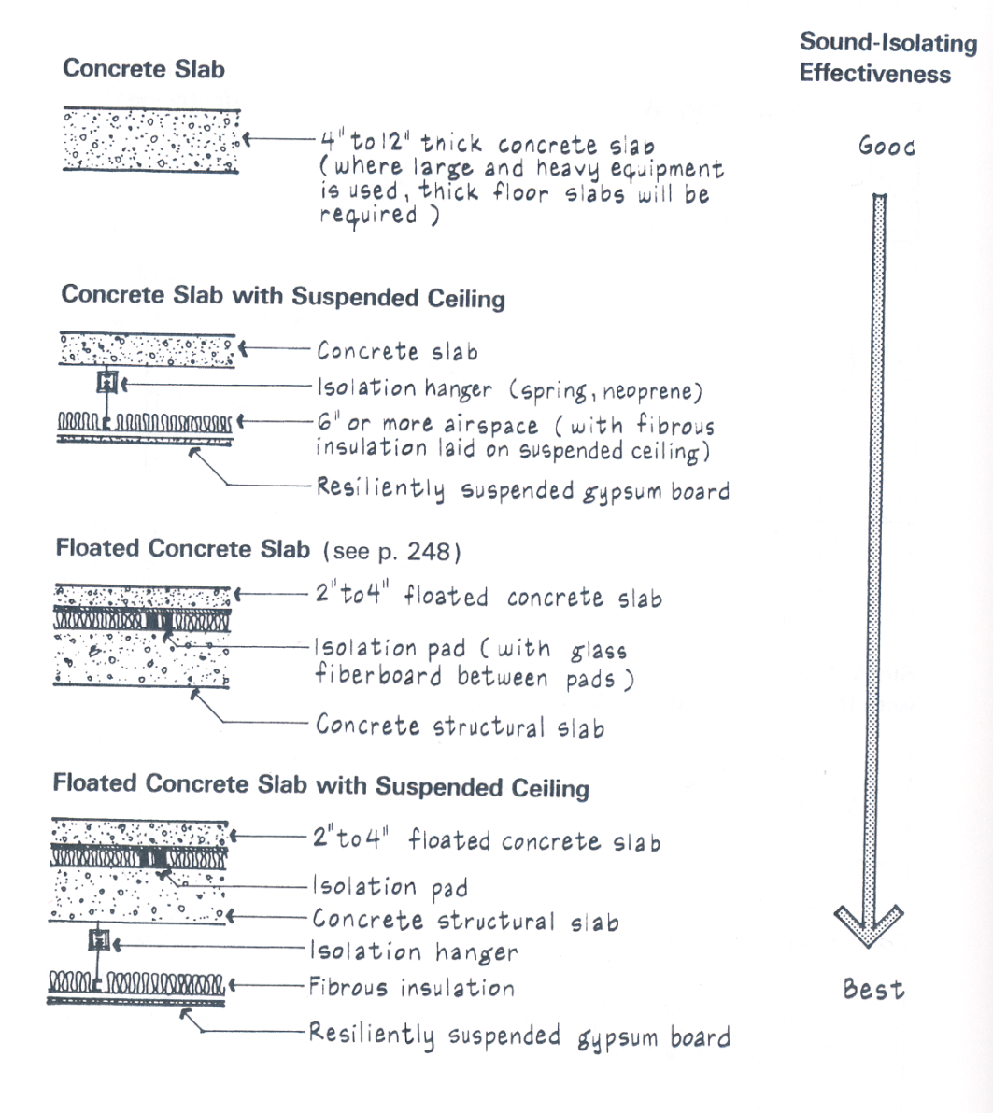

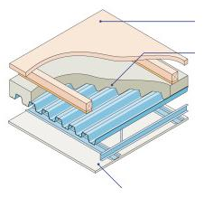
Existing Building Information
Project Goals
Structural Depth Study
Construction Management Breadth Study
Acoustical Breadth Study
Conclusions
Acknowledgements
Questions and Comments
Pool Area/Exercise Room above Meeting Rooms
Existing Floor
Proposed Floor System

Slide 21
Existing Building Information
Project Goals
Structural Depth Study
Construction Management Breadth Study
Acoustical Breadth Study
Conclusions
Acknowledgements
Questions and Comments
Structural Depth
  Slab Thickness
  Beam and Column Layout
  Foundation System
Construction Management Breadth
  Cost Analysis
  Schedule Analysis
Acoustical Breadth
  Pool Area
  Exercise Room
Conclusions

Slide 22
RTKL Associates
  Bob Knight
  Jeff Kennelly
Hensel Phelps
  Bill Thumm
The Pensylvania State University
  Prof. Moses Ling
  Dr. Ali M. Memari
  Prof. M. Kevin Parfitt
  Prof. Robert Holland
Existing Building Information
Project Goals
Structural Depth Study
Construction Management Breadth Study
Acoustical Breadth Study
Conclusions
Acknowledgements
Questions and Comments
Acknowledgements

Slide 23
Existing Building Information
Project Goals
Structural Depth Study
Architectural Breadth Study
Facade Detailing Breadth Study
Conclusions
Acknowledgements
Questions and Comments
Questions

